Slide 1


K.RAMAKRISHNAN COLLEGE OF TECHNOLOGY
(AUTONOMOUS), TRICHY
CREATING BASIC MAPS TO DISPLAY POPULATION DENSITY OF INDIAN STATES
PRESENTED BY
2303811724321067-MOHAMED FIRDOUS S

Slide 2
PRESENTATION OVERVIEW
Problem Identification and Analysis
Objective
Proposed Work Architecture & Module Design
Block diagram of proposed system
Module Description
Module Implementation
R Programming Implementation
Source Code
Output Snapshots
Conclusion

Slide 3
PROBLEM IDENTIFICATION
.
Problem Identification
Population data from sources like the Census is vast and difficult to interpret manually.
Users lack intuitive tools to explore population density by state interactively.
Traditional tabular formats make it hard to identify high or low-density regions at a glance.
Problem Analysis
There is a need for a dynamic, map-based visualization platform for population data.
Interactive features like filtering and color-coded density maps can enhance data exploration.
A web-based interface using R Shiny can make data accessible and understandable for all users.

Slide 4
OBJECTIVE
To develop a user-friendly dashboard that:
Displays population density data for Indian states.
Provides both tabular and visual (map-based) views.
Supports CSV file uploads and filtering by density level

Slide 5
Proposed Work Architecture & Module Design
Frontend: Built using R Shiny and shinydashboard to provide an intuitive and interactive user interface.
Backend: Processes uploaded data and user interactions using R functions and dplyr for data transformation.
Visualization: Implements Leaflet for map visualization and DT for dynamic table display of population data.
Modules: Includes Data Upload & Cleaning, Table View, Map Visualization, User Interface, and Integration & Testing.
Security & Deployment: Supports basic session handling and is deployable via shinyapps.io or local server environments.

Slide 6



BLOCK DIAGRAM
UPLOAD FILE
TABLLE VIEW
Data Cleaning and Processing
MAP VIEW
Filter Logic Highest / Lowest /All

Slide 7
MODULES DESCRIPTION
Data Upload & Cleaning Module
Table View Module
Map Visualization Module
User Interface Design using Shiny
Integration and Testing Module

Slide 8
MODULES IMPLEMENTATION
Data Upload & Cleaning Module
Uploads .csv files containing population and state data
Parses string numbers with commas into numeric format
Merges data if multiple datasets are used
Prepares clean dataset for visualization
Cleans data by removing missing or invalid entries

Slide 9
MODULES IMPLEMENTATION
Table View Module
Presents cleaned dataset in an interactive table
Allows sorting and searching by state or density
Supports pagination for large datasets
Reflects filtering choices from the user
Makes comparison and data interpretation easier

Slide 10
MODULES IMPLEMENTATION
Map Visualization Module
Displays population density data using interactive maps
Uses color-coded markers to represent density levels
Tooltips show state name and population details
Zoom and pan for exploring different regions
Highlights patterns and outliers geographically

Slide 11
MODULES IMPLEMENTATION
User Interface Design using Shiny
Built using R Shiny’s reactive UI components
Sidebar includes controls for upload, filter, and view selection
Tabs for toggling between Table and Map views
Responsive layout for desktop and mobile
Clean, user-friendly interface for smooth navigation

Slide 12
MODULES IMPLEMENTATION
Integration and Testing Module
Combines all modules into a fully functional Shiny app
Validates input handling and reactive updates
Tests usability across devices and browsers
Debugs and optimizes UI and server logic
Ensures smooth operation before final deployment

Slide 13
DATA SCIENCE CONCEPTS
Shiny – For interactive UI and server logic.
leaflet – For dynamic geographic visualization.
DT – For interactive and filterable tables.
dplyr – For data filtering and manipulation.

Slide 14
SOURCE CODE
library(shiny)
library(DT)
library(leaflet)
library(dplyr)
state_coords <- data.frame(
State = c("Uttar Pradesh", "Bihar", "Maharashtra", "West Bengal", "Tamil Nadu",
"Rajasthan", "Karnataka", "Gujarat", "Andhra Pradesh", "Madhya Pradesh"),
Lat = c(26.85, 25.59, 19.75, 22.57, 11.12, 27.02, 15.31, 22.26, 15.91, 23.52),
Lon = c(80.91, 85.13, 75.71, 88.36, 78.15, 74.22, 75.71, 72.57, 79.74, 77.81)
)
ui <- fluidPage(
titlePanel("Density Viewer"),
sidebarLayout(
sidebarPanel(
fileInput("file", "Upload CSV File (State, Density)", accept = ".csv"),
selectInput("filter_type", "Filter Population Density:",
choices = c("All", "Highest Density", "Lowest Density"))
),
mainPanel(
tabsetPanel(
tabPanel("Table View", DTOutput("density_table")),
tabPanel("Map View", leafletOutput("density_map", height = 600))
)
)
)
)
server <- function(input, output) {
user_data <- reactive({
req(input$file)
df <- read.csv(input$file$datapath, stringsAsFactors = FALSE)
df$Density <- as.numeric(gsub(",", "", df$Density))
merged <- df %>%
inner_join(state_coords, by = "State")
merged
})

Slide 15
SOURCE CODE
leaflet() %>%
addTiles() %>%
addCircleMarkers(data = filtered_data(),
lat = ~Lat,
lng = ~Lon,
radius = 10,
color = ~pal(Density),
stroke = TRUE,
fillOpacity = 0.8,
label = ~paste(State, ": ", Density)) %>%
addLegend("bottomright", pal = pal, values = user_data()$Density,
title = "Population Density")
})
}
shinyApp(ui = ui, server = server)
filtered_data <- reactive({
data <- user_data()
if (input$filter_type == "Highest Density") {
data %>% filter(Density == max(Density, na.rm = TRUE))
} else if (input$filter_type == "Lowest Density") {
data %>% filter(Density == min(Density, na.rm = TRUE))
} else {
data
}
})
output$density_table <- renderDT({
datatable(filtered_data()[, c("State", "Density")], options = list(pageLength = 10))
})
output$density_map <- renderLeaflet({
req(filtered_data())
pal <- colorNumeric(palette = c("green", "yellow", "red"), domain = user_data()$Density)

Slide 16
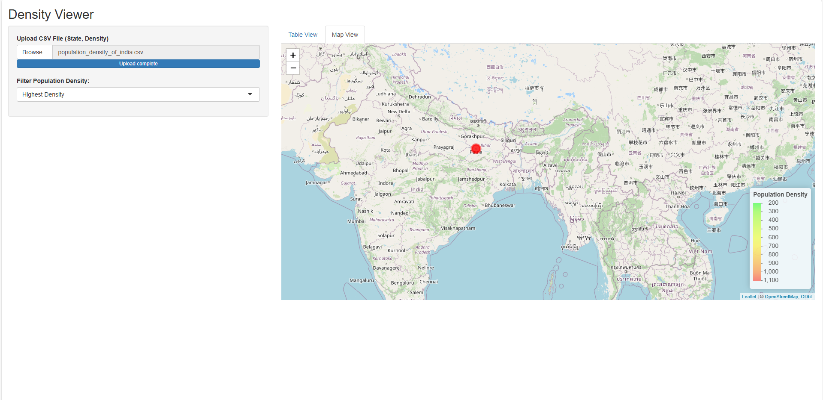
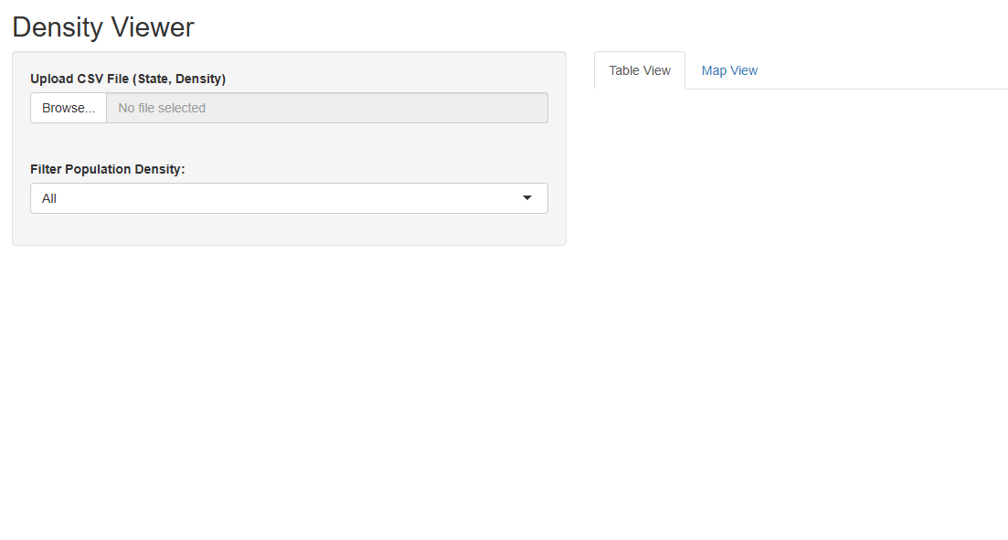
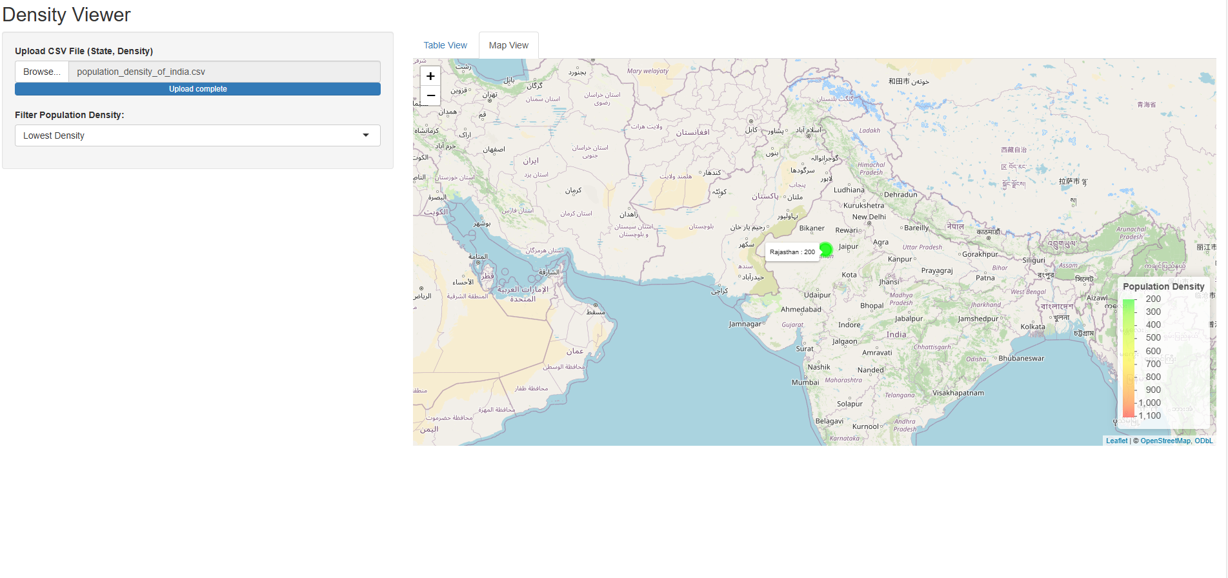
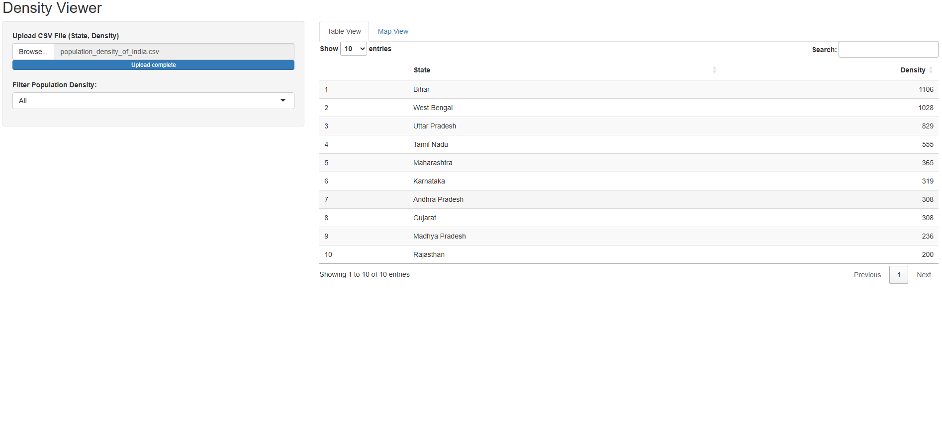
Output Snapshots

Slide 17
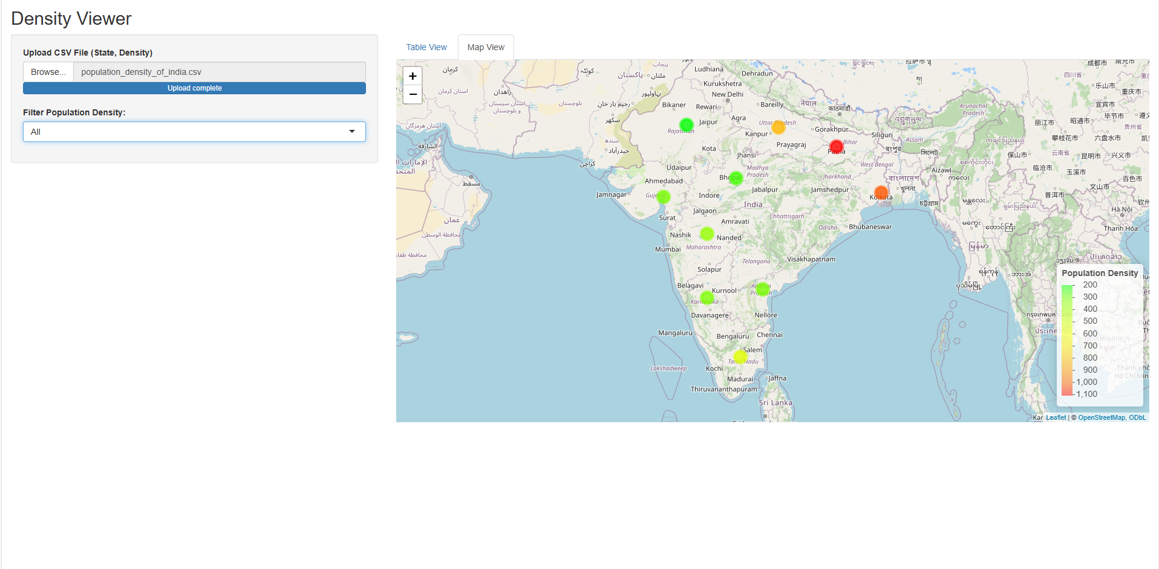
Output Snapshots

Slide 18
CONCLUSION
Successfully built a dynamic “Density Viewer” dashboard using R.
Helps visualize and analyze population density across Indian states.
Easy to use and extendable for other geospatial datasets.
Future scope includes:
Role-based Access System: Enable different user roles such as administrators, researchers, and public users with tailored access and functionality.
Downloadable Reports: Allow users to export filtered data and visualizations in formats like PDF, CSV, or PNG for offline analysis.

Slide 19
THANK YOU

